Slide 1
Experiential Learning @ Online
Elsa Lam
Faculty of Social Sciences
HKU

Slide 2
Social Innovation & Global Citizenship (SIGC) @ Faculty of Social Sciences, HKU
12 credits local internship & 12 credits non-local internship
Graduation requirements
Summer 300 students; term-times: 60 students

Slide 4
Journey of experiential learning turning online

Slide 5
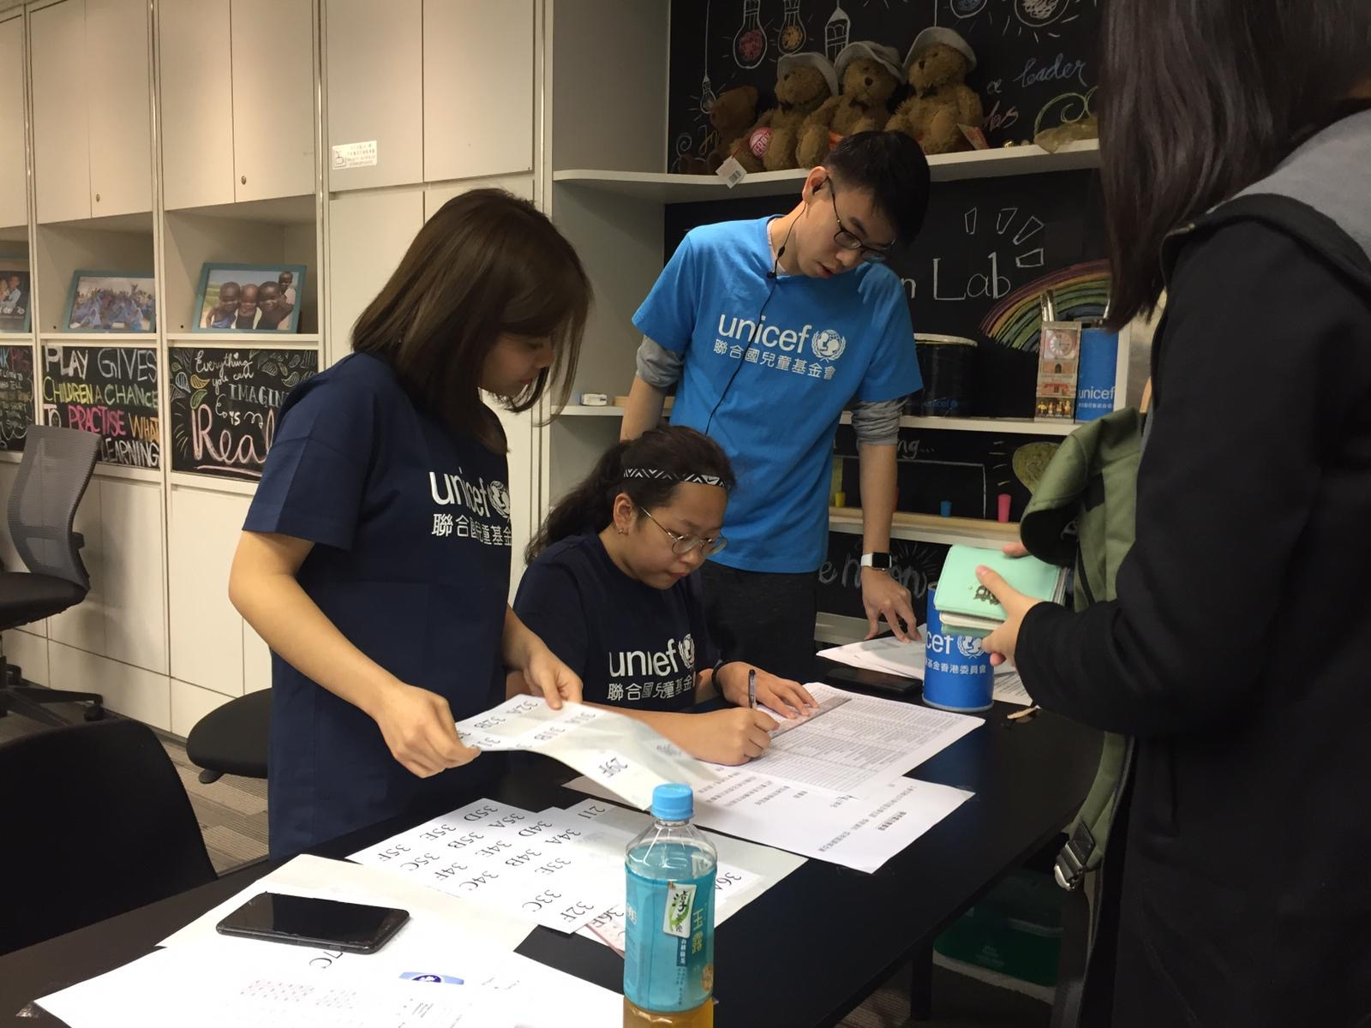
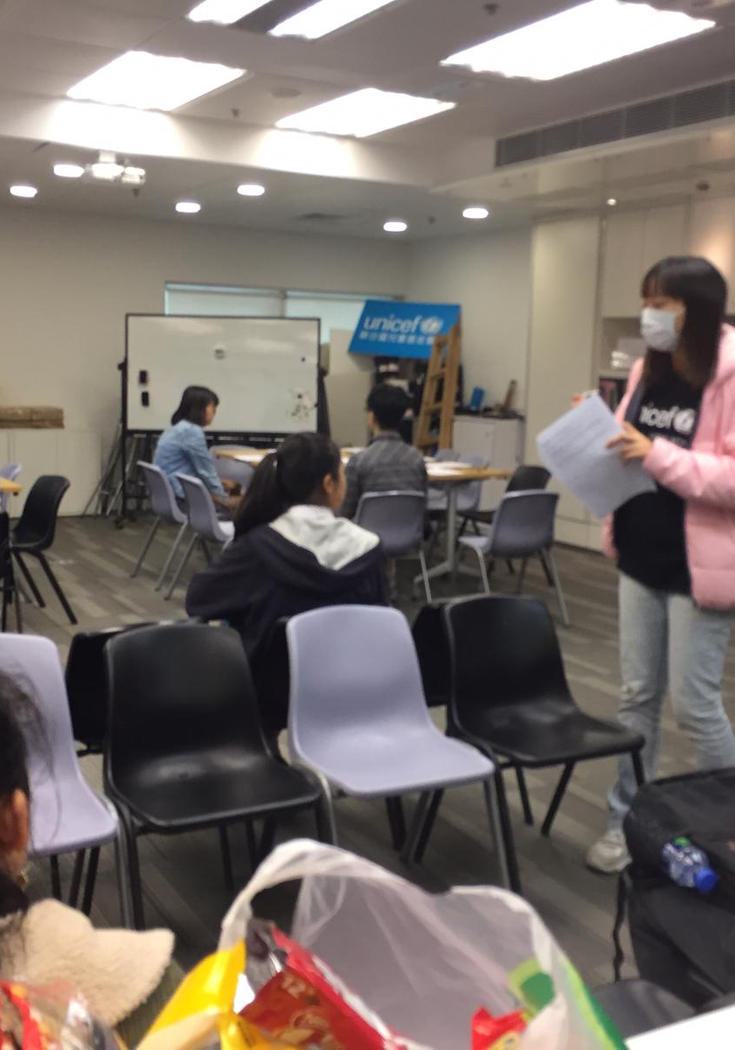
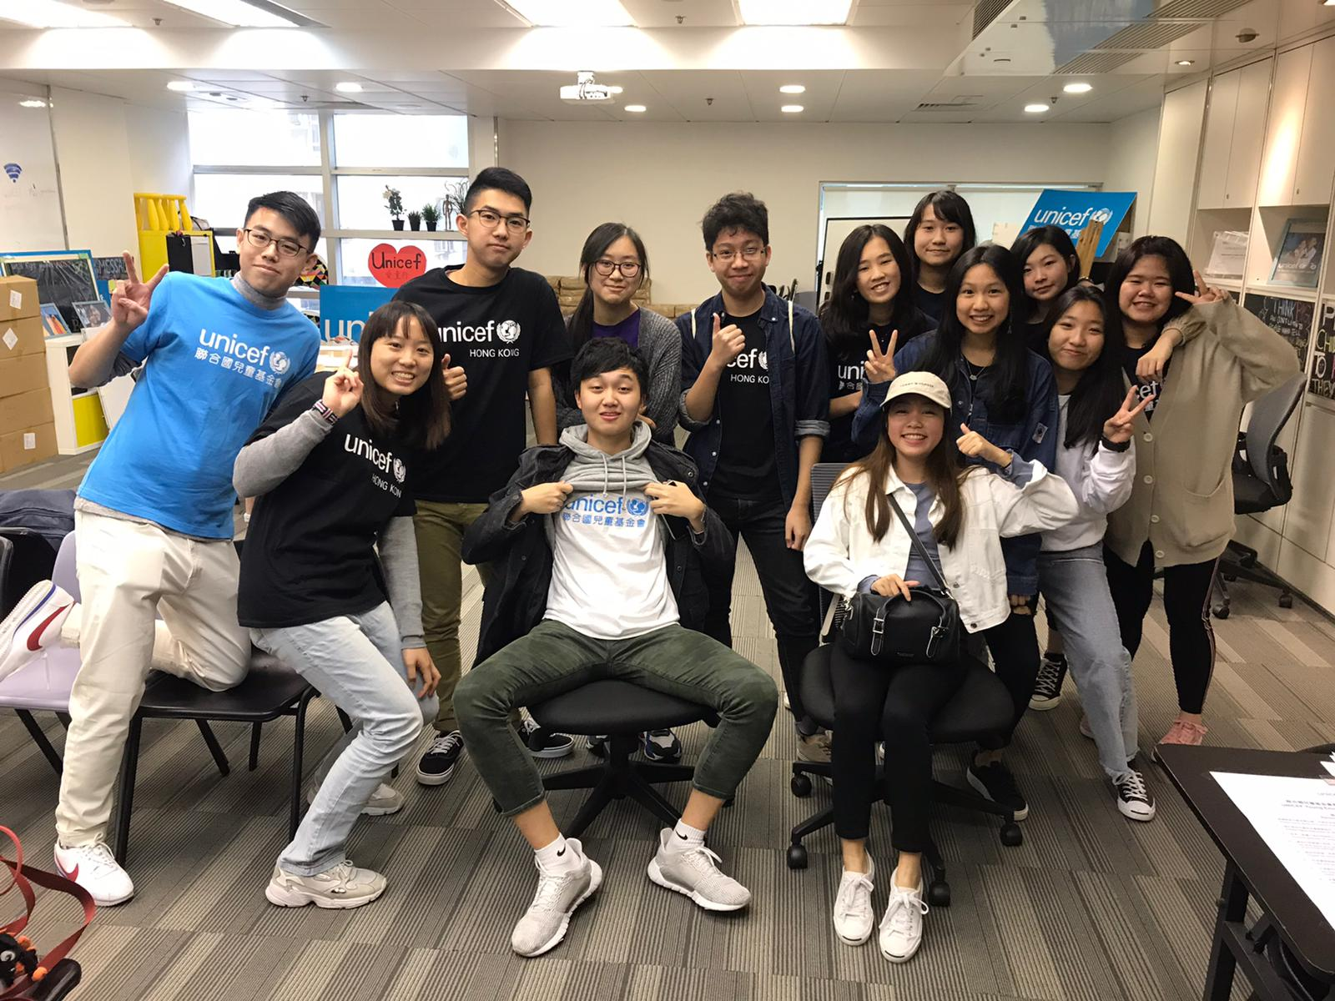
Original Plan
There would be different works at Young Envoys Programme, public engagement event and office setting for different skills.

Slide 6
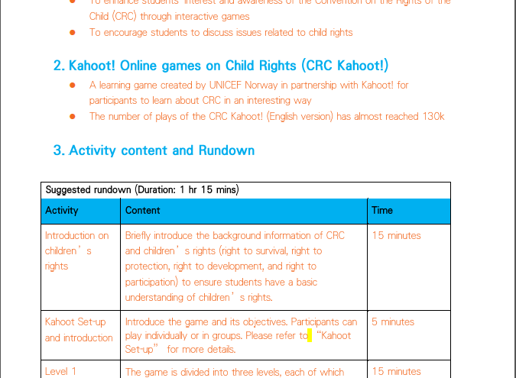
Plan changed….
When everyone works from home & everything is conducted online:
For localizing the global resources
For planning training workshops online

Slide 7
What did they say…
Community partner
Students
The students are indigenous netizens. They are far more experienced than my generation about the virtual world. Also, They have prior knowledge of Zoom. They are very creative and knowlegable.
We used what we learnt from our Zoom classes to plan for the lesson and make the online learning fun. For examples: mentimeter, online games, breakout room, chat room…

Slide 8
Together, we co-created something NEW
Suspension of local primary and secondary schools: WITHOUT a taste of school context from child rights perspective
Something NEW: UNICEF HK’s local response to COVID-19 outbreak

Slide 9
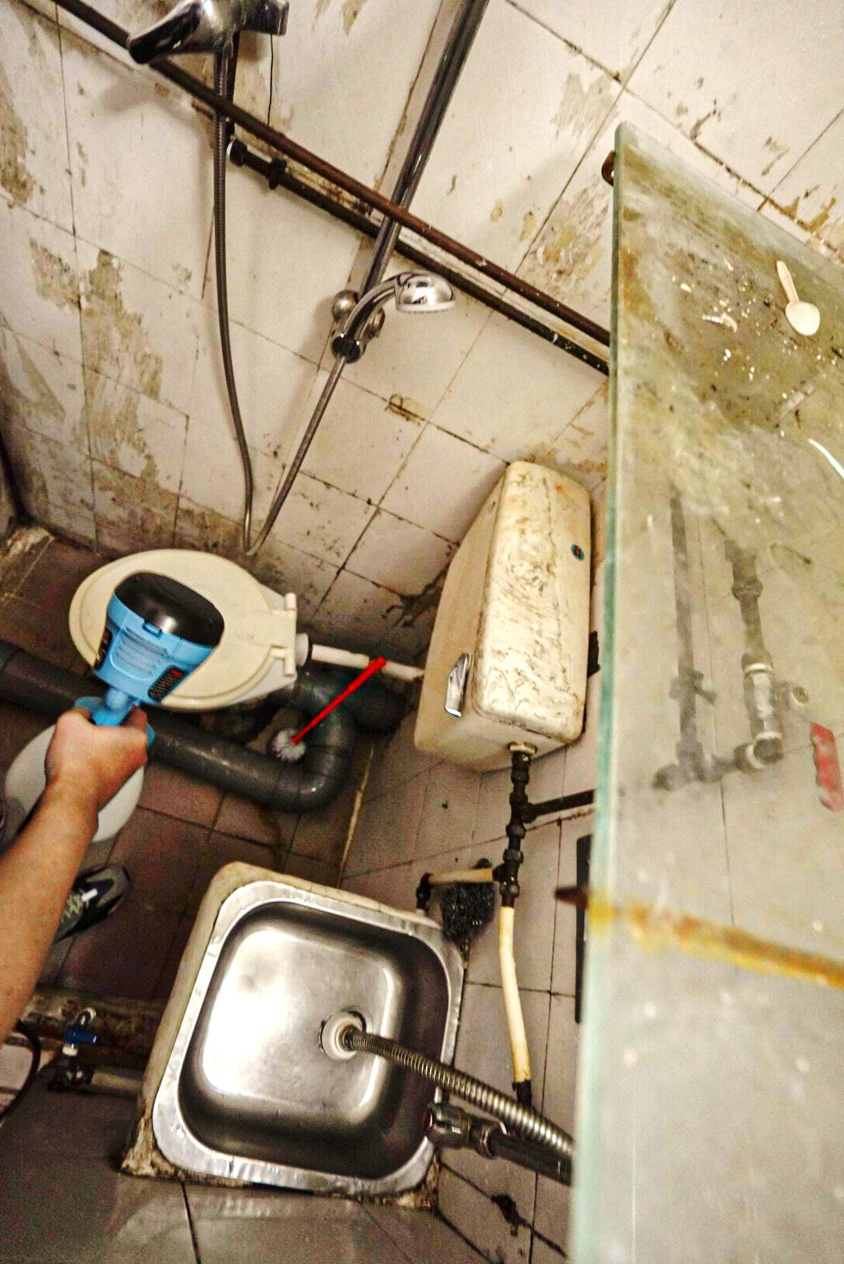
For every child, hygiene
UNICEF HK has launched “for every child, hygiene” to help grassroots families improve home hygiene, in particular toilet sanitation, and raise awareness on personal hygiene to prevent the spread of viruses and safeguard the health of vulnerable children and their families. Main service targets：
At least one child aged 17 or below, or pregnant woman in the household; and
Meet any one of the following circumstances below:
Living in sub-divided flat, rooftop partition unit, squatter, unit in non-residential building, co-living unit, or tenement unit
Household with a child with diversified needs (including disabilities, chronic illness, special education needs) (living in designated residence above or public housing unit)
Household of single-parent, intergenerational co-living or unemployed families (living in designated residence above or public housing unit)
Overcrowded household in public rental housing
Families in need with referral from school, organization or social worker, or children’s home with home setting residential child care service
Registration method for families: Interested families must contact and register through supporting organizations.

Slide 10
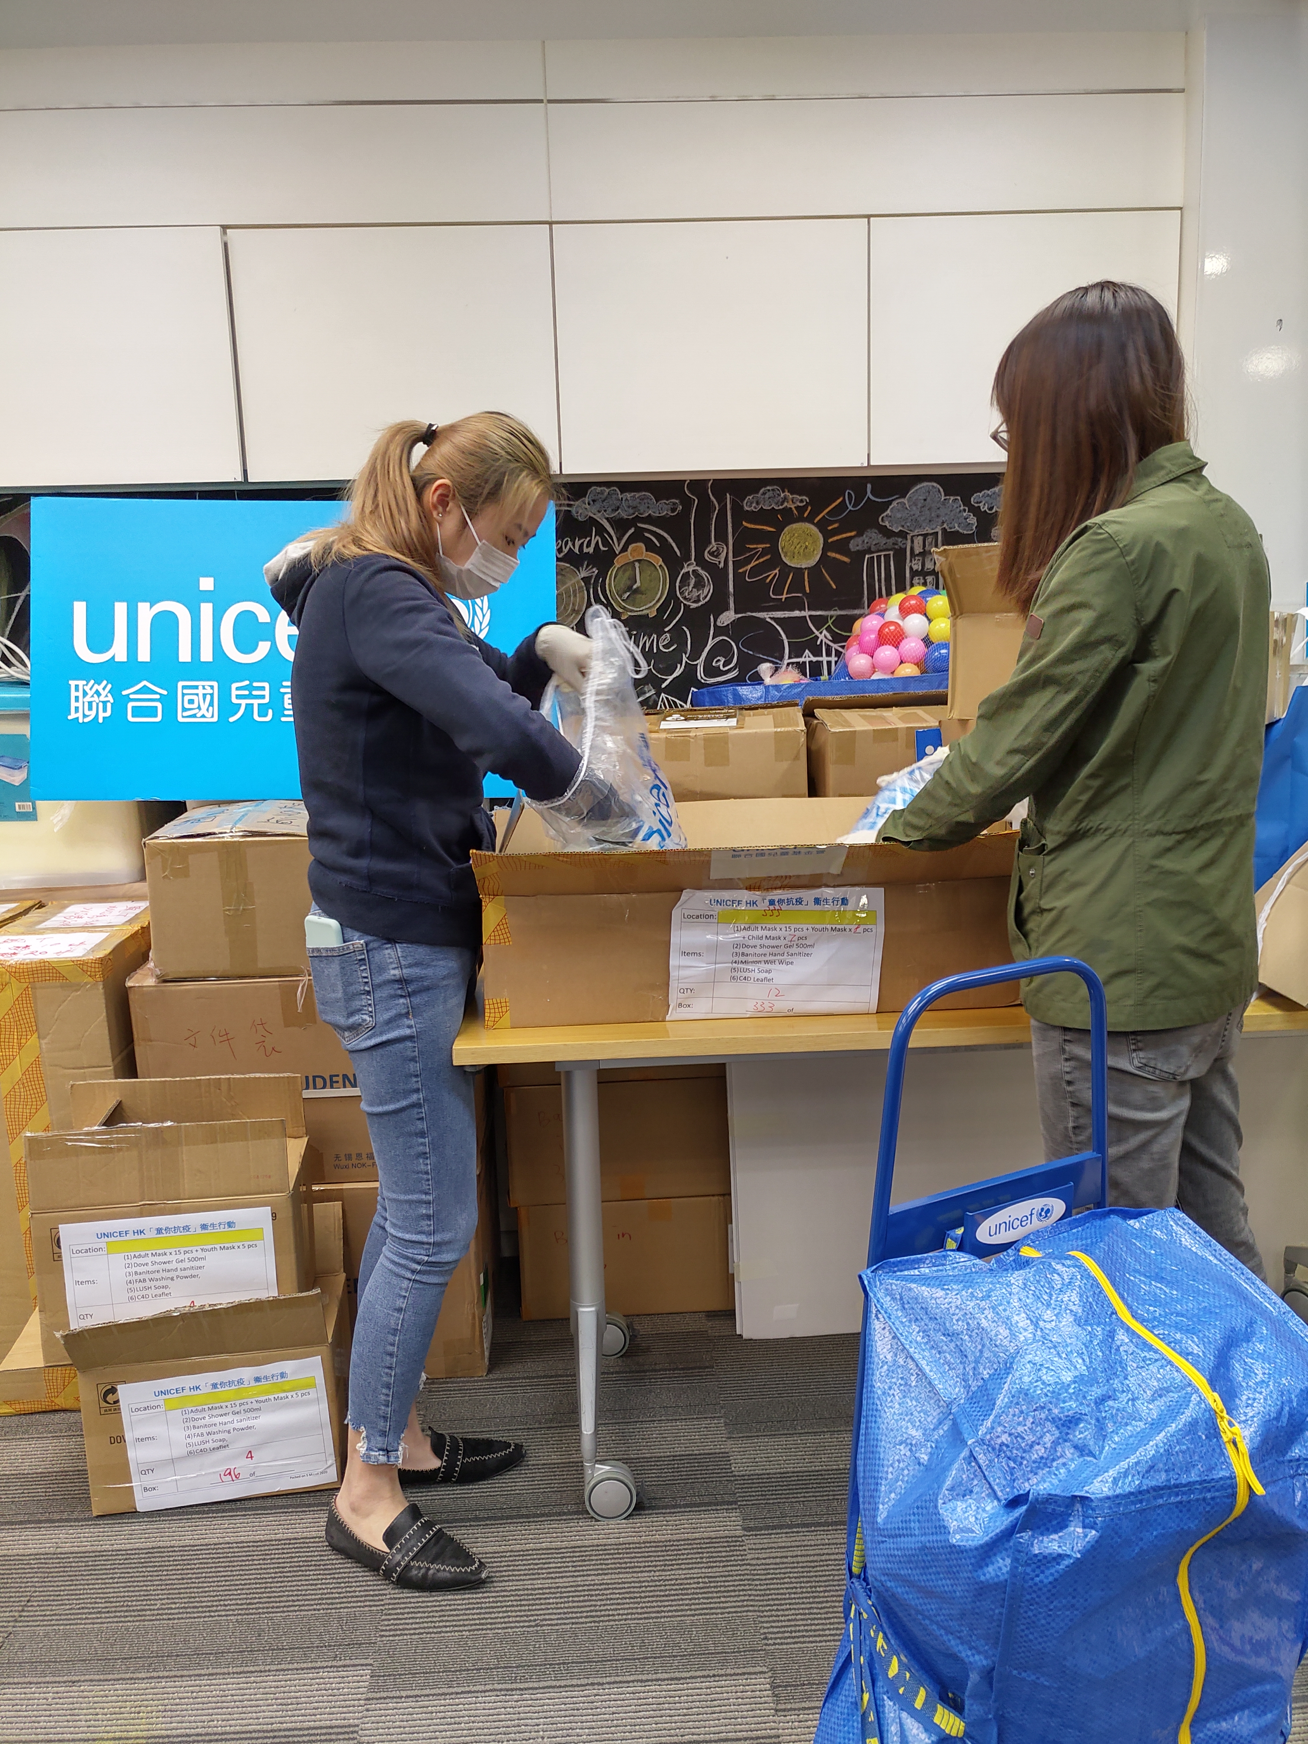
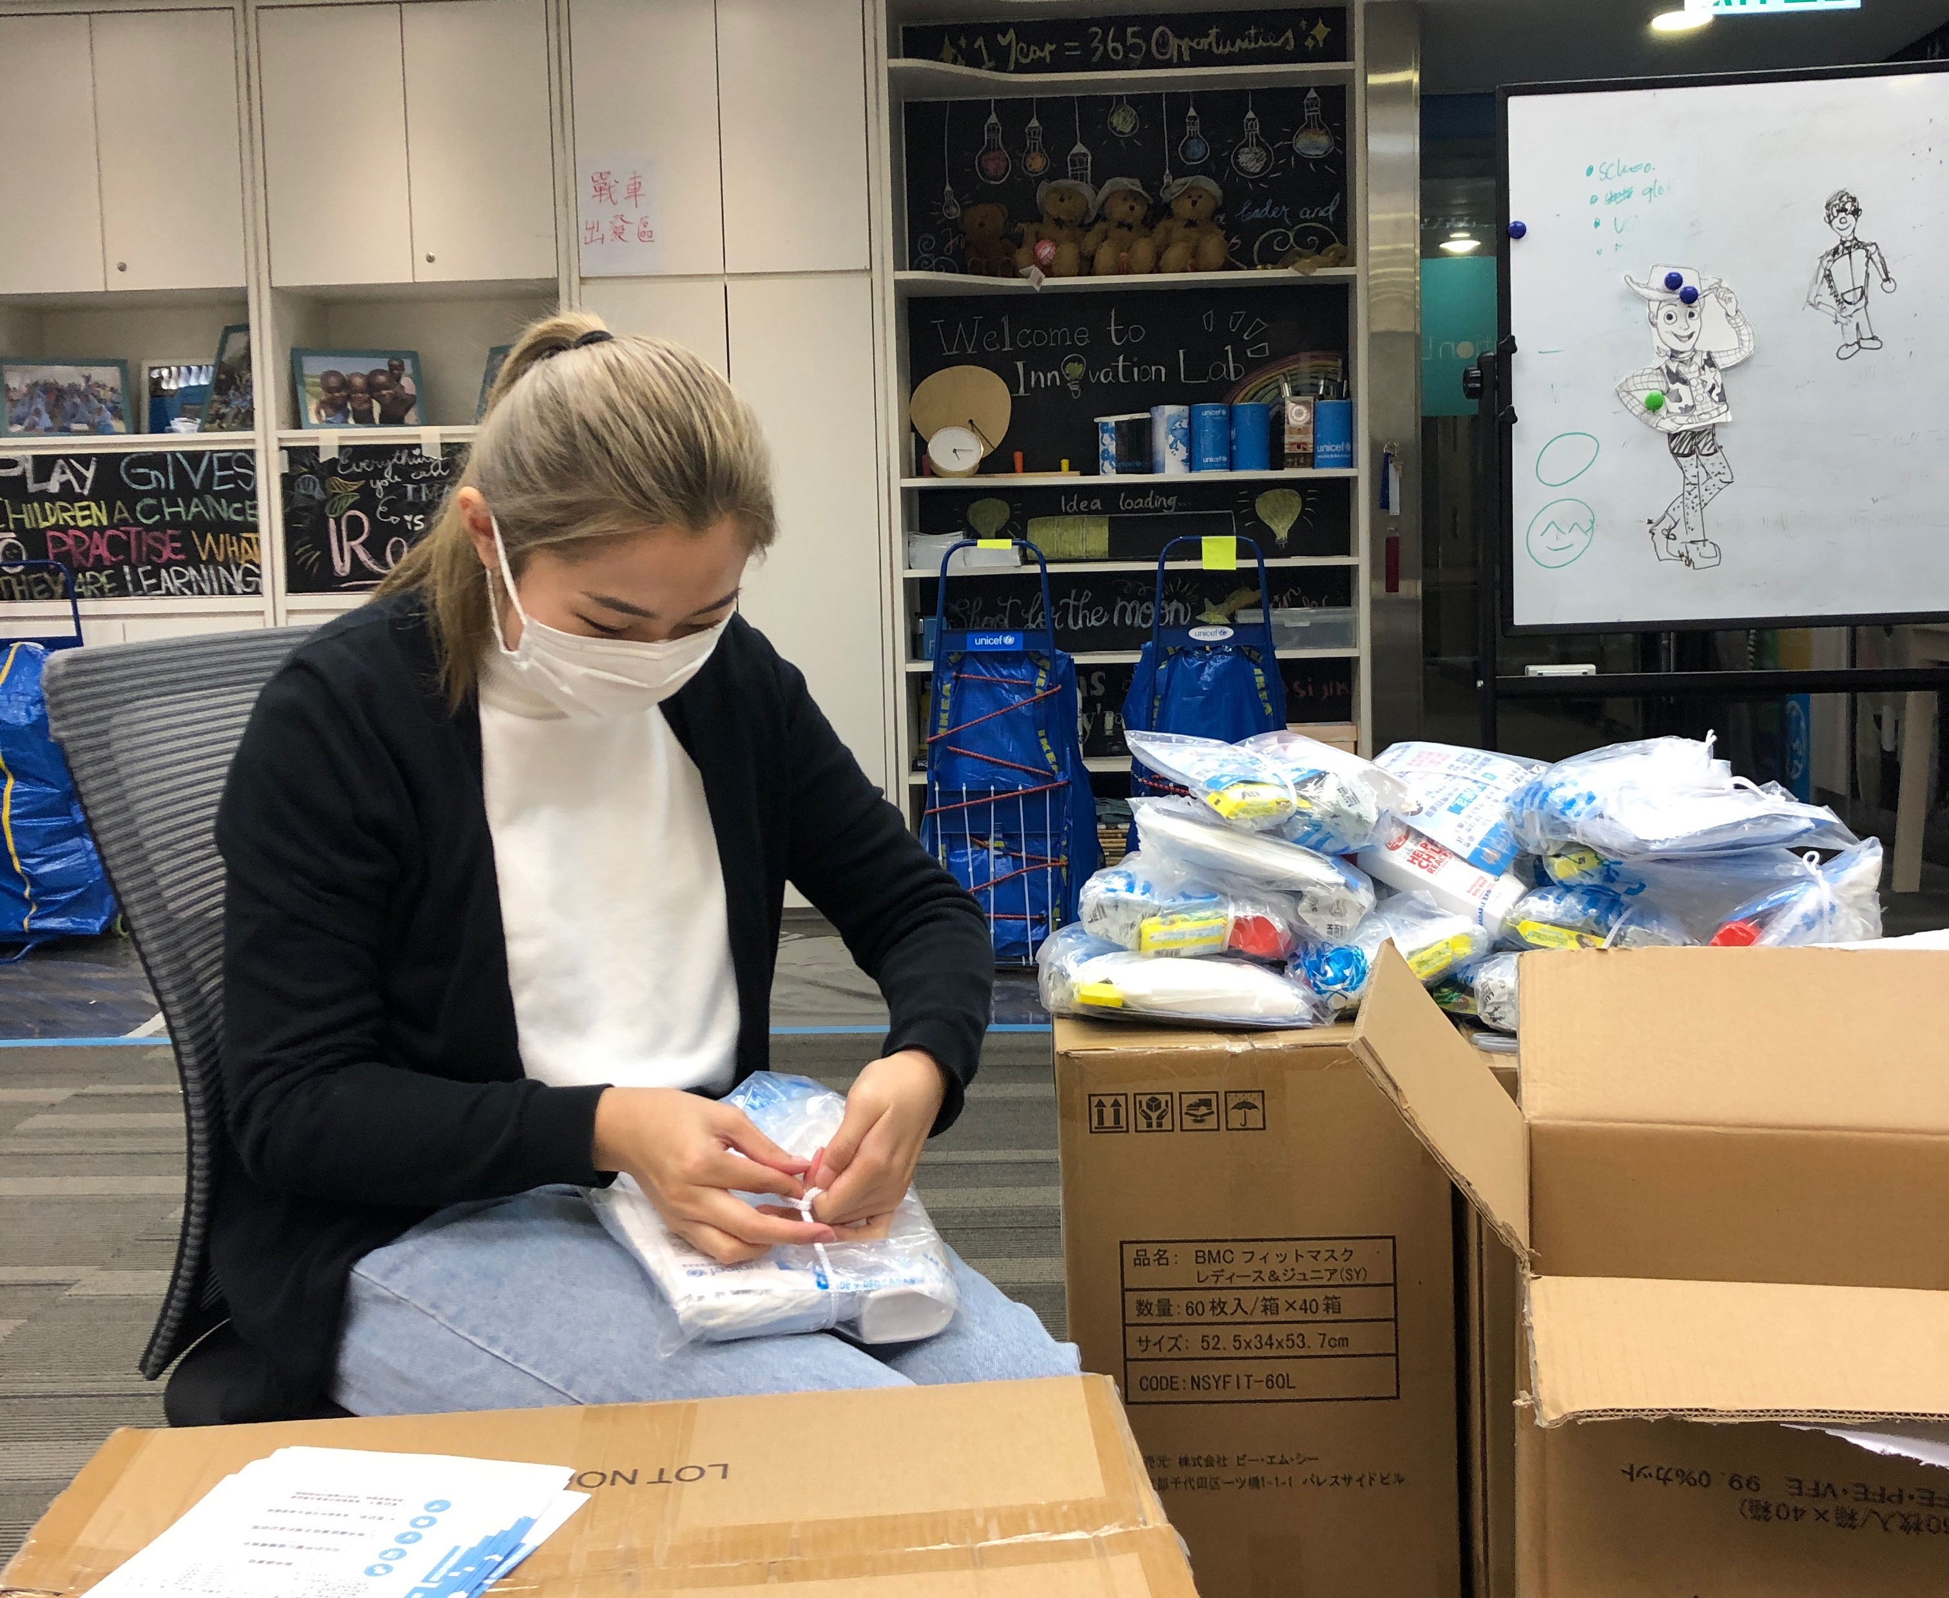
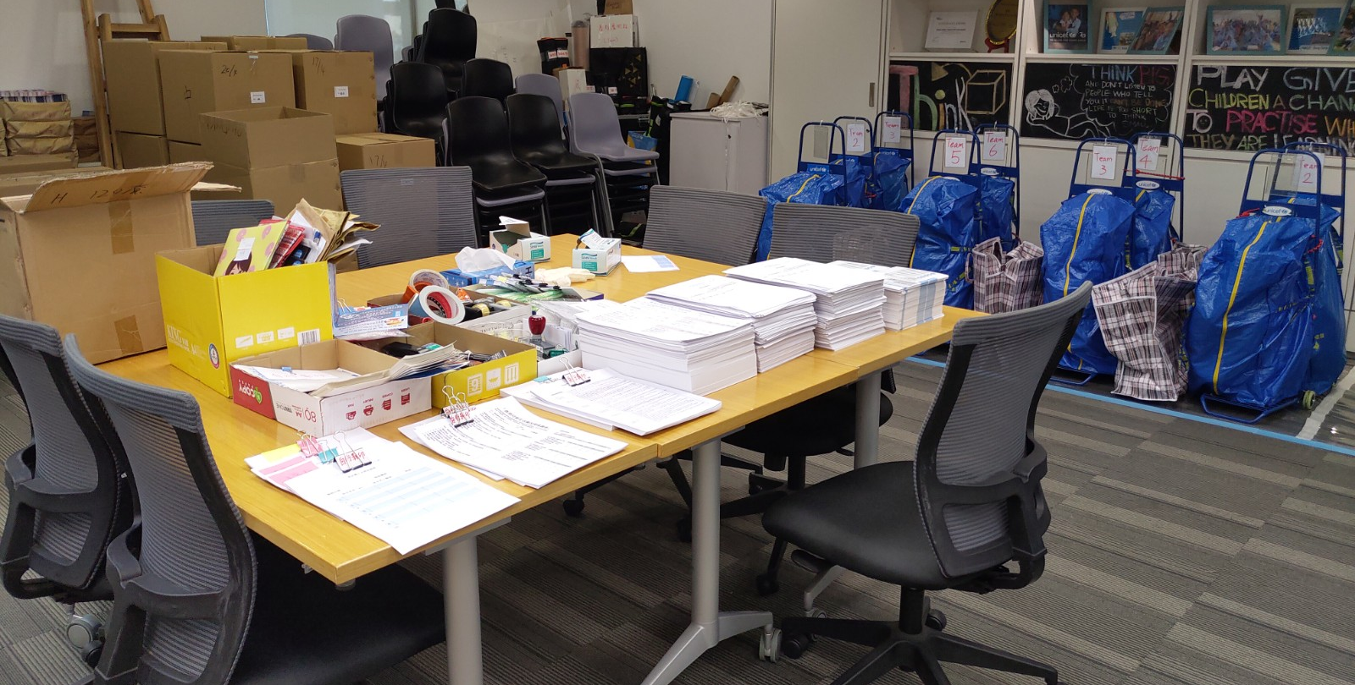
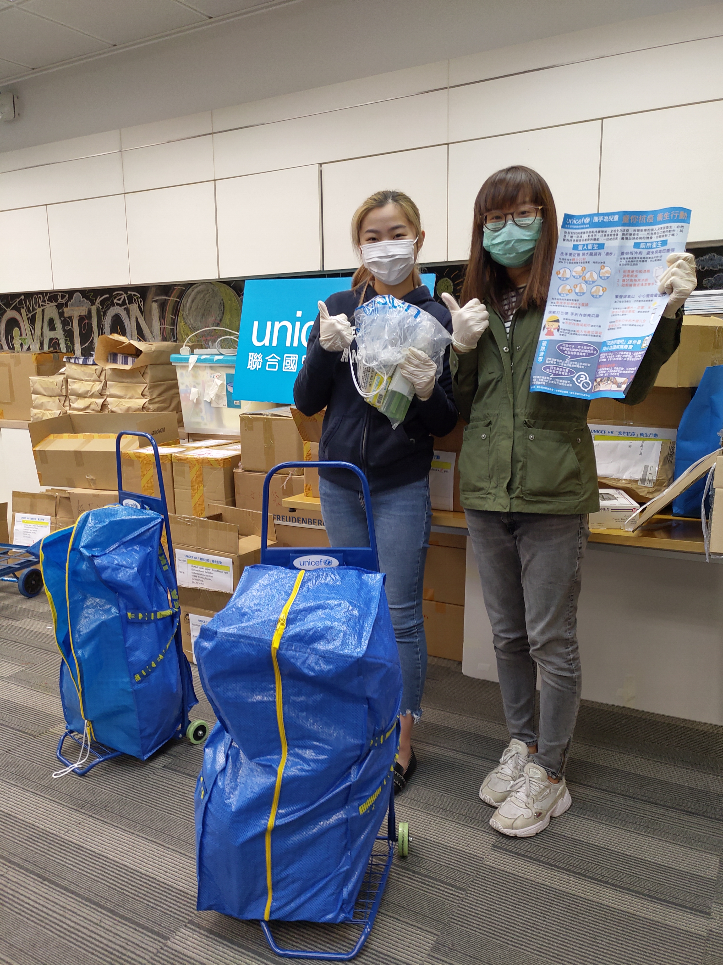
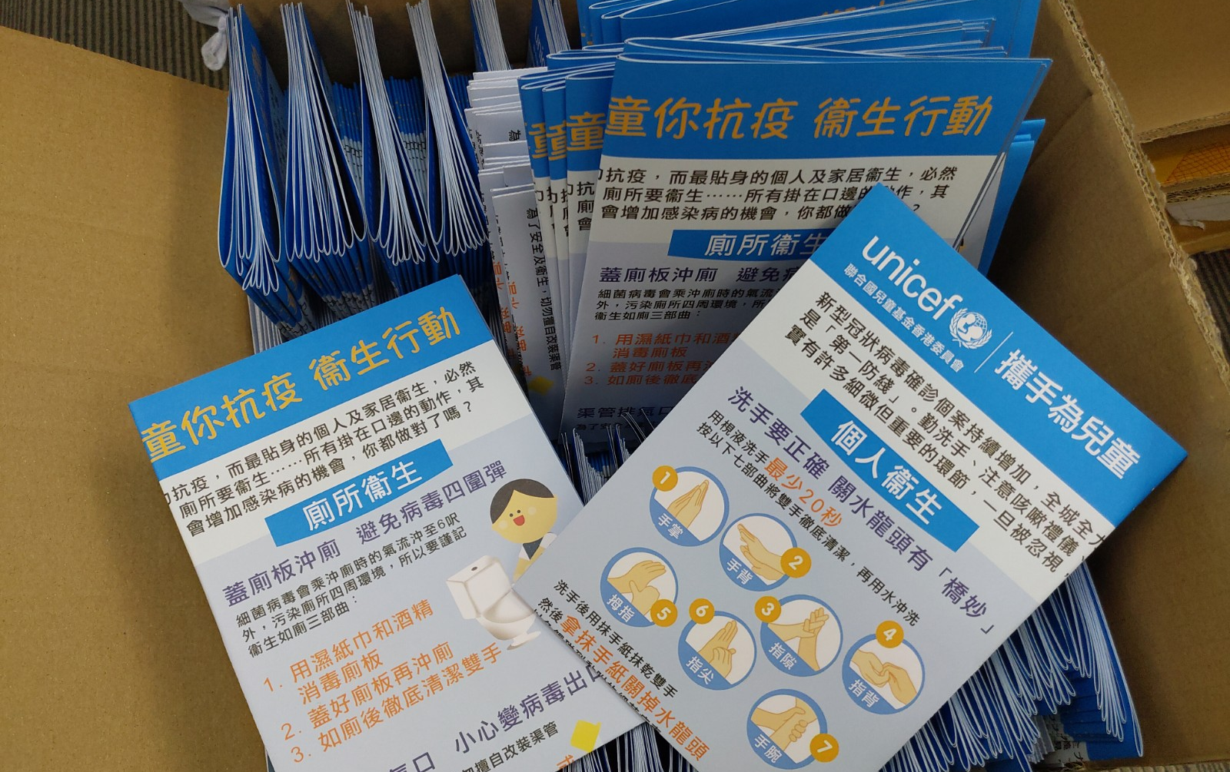
Interns’ inputs @ ‘for every child, hygiene’
Back-office support

Slide 11
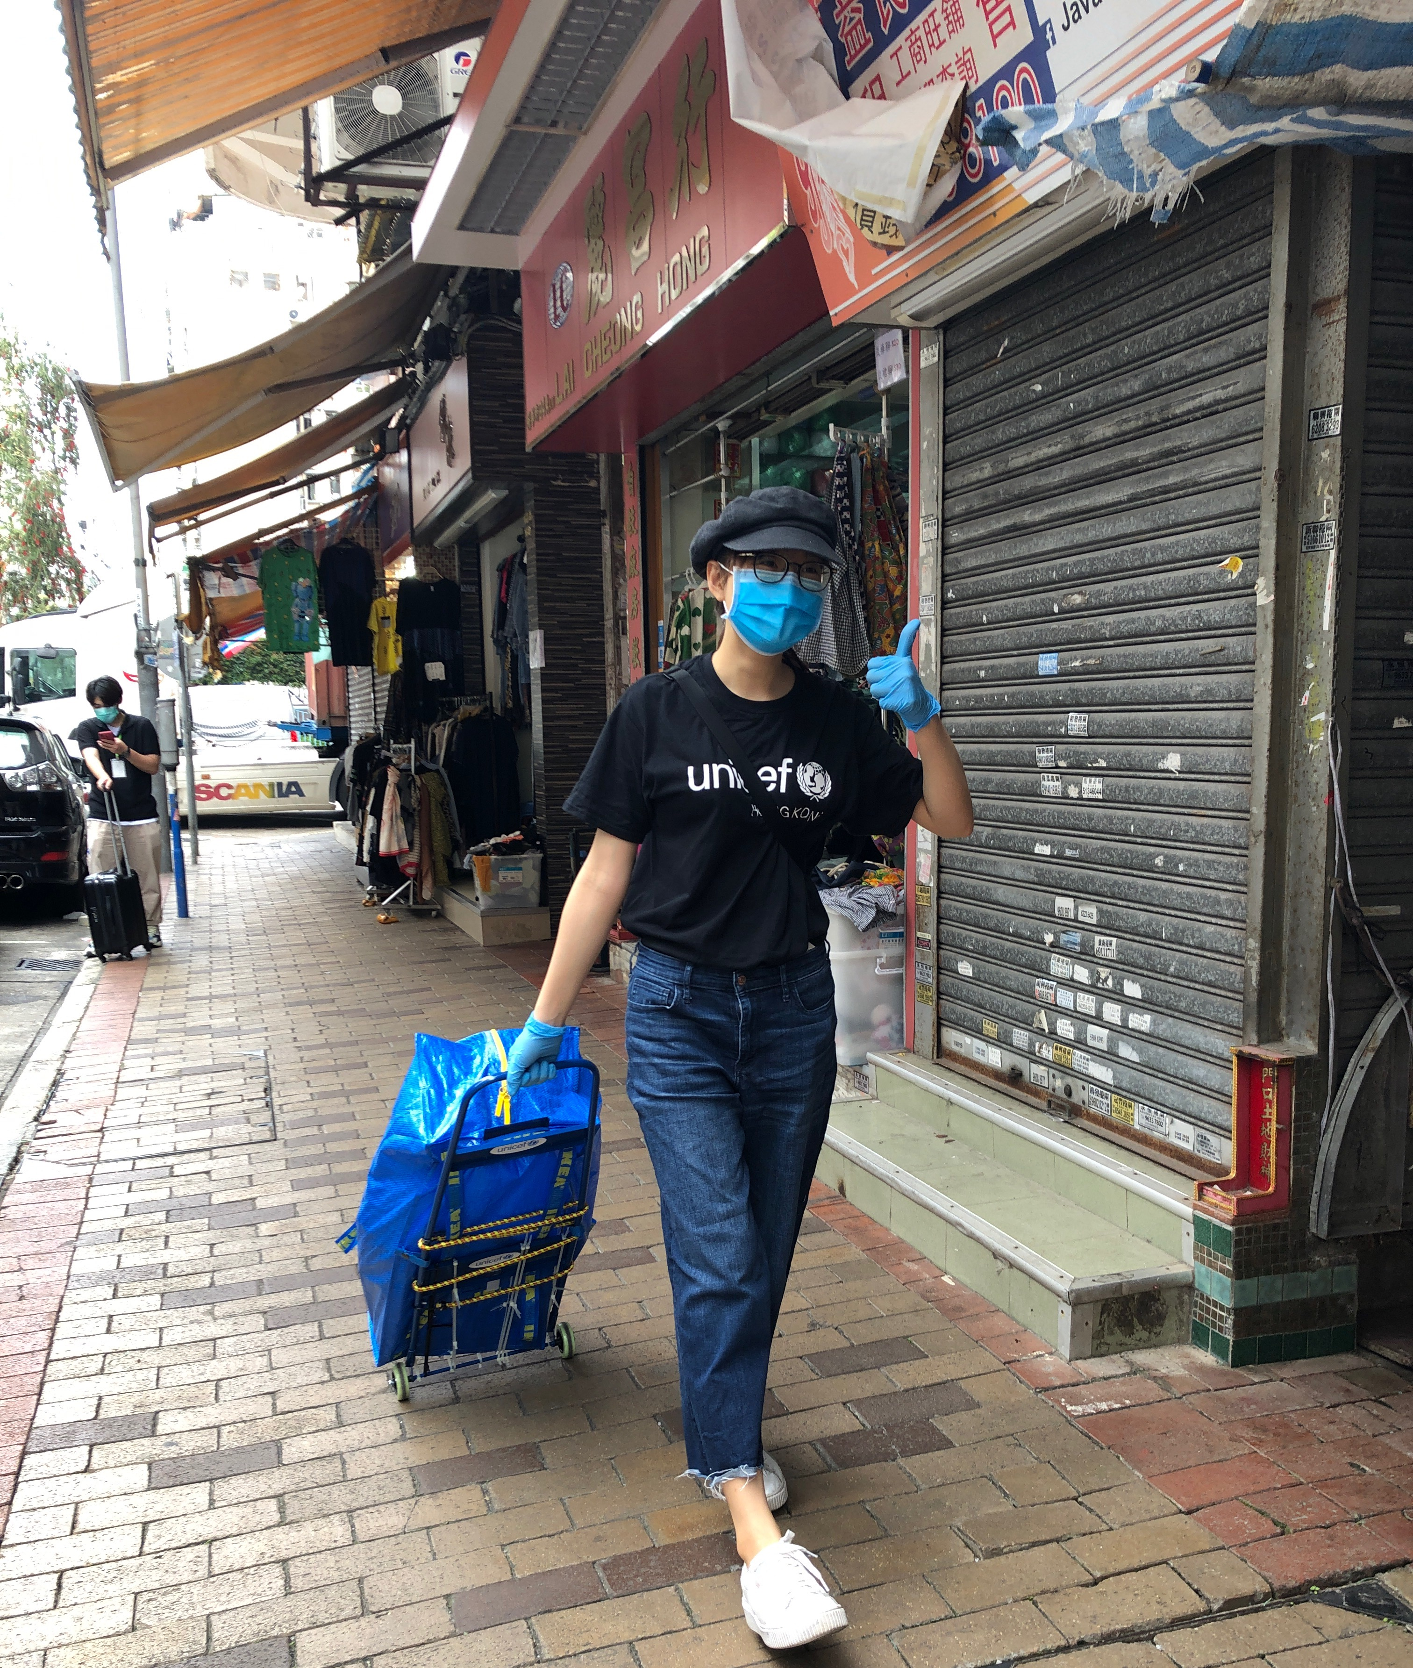
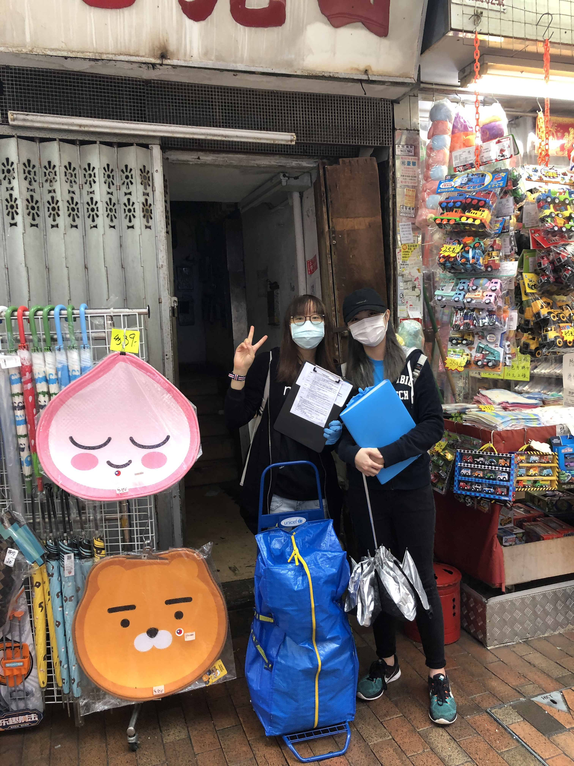
Interns’ inputs @ ‘for every child, hygiene’
Online Volunteer training and on-site home visit

Slide 12
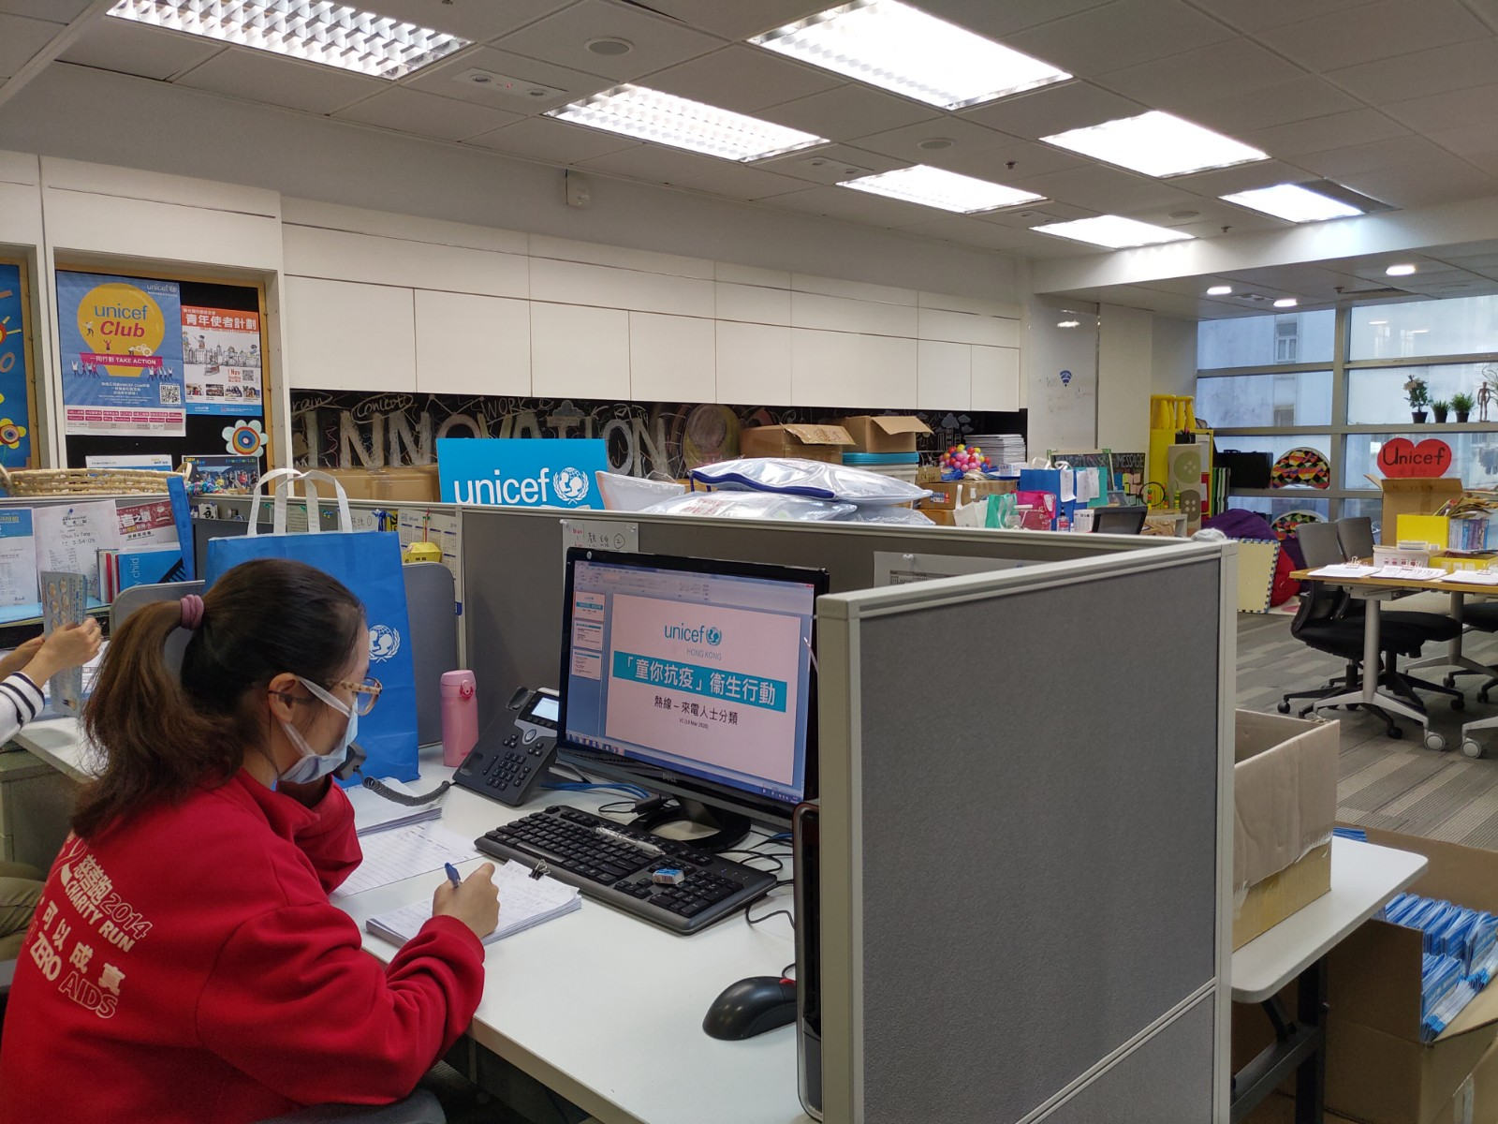
Interns’ inputs @ ‘for every child, hygiene’
Handling public enquiries

Slide 13
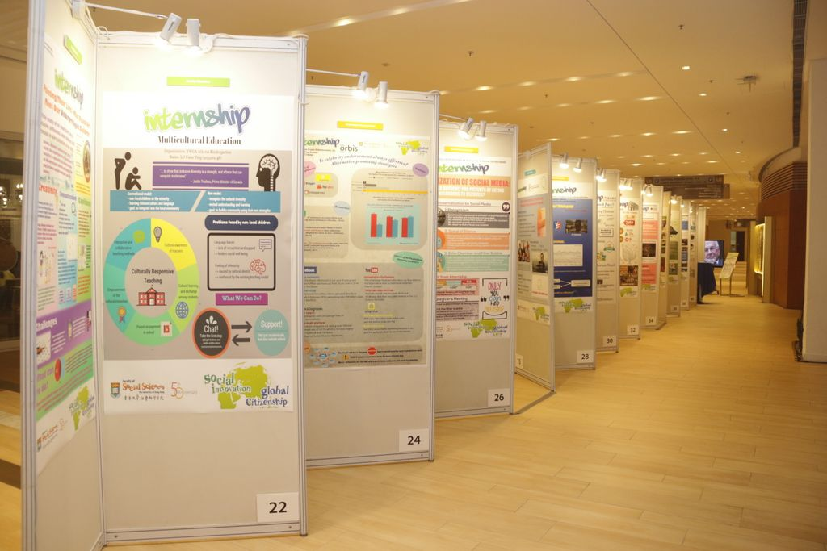
Virtual online poster conference

Slide 14
An HKU intern’s reflection on ‘for every child, hygiene’
“By visiting people living in sub-divided flats, my understanding on the living condition of grassroots in our society is greatly deepened. This helped me to be a more empathetic person and further increased my social awareness.”

Slide 15
HKU interns’ reflection on internship arrangement
“I am so grateful to have the opportunity to become a part of UNICEF. I have learnt many new skills and met a lot of amazing people here.”
“It was a fruitful year that I cherish all the valuable experience that I have gained in UNICEF HK, and the supervisors are very nice. Thank you UNICEF! ^^ “
“The internship experiences allow me to be more familiar with the issues of child rights promotion in Hong Kong and gain more in-depth insights about the operation in UNICEF HK. “

Slide 16
Look forward to summer internship……
Global citizenship at Home
Hydride of mode of working

