Slide 1
Online T&L 2019-20: The HKU Experience
Part 4: Assessment beyond the curriculum
UGC T&L Project: Strengthening the alignment of residential educational & university educational aims
Sam Chu, Warden of Swire Hall
PhD in Education (e-Learning, UCL Institute of Education, UK)
PhD in Education (Information Science, HKU, HK)
Associate Professor, Teacher Education & Learning Leadership Unit
Faculty of Education, HKU

Slide 2
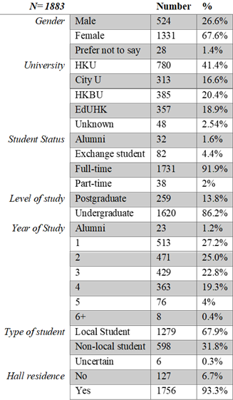
Survey Participants in 2018/19
A total of 1883 participants
living in or affiliated to
residential halls from
four local and one overseas
Universities responded to
the survey.

Slide 3
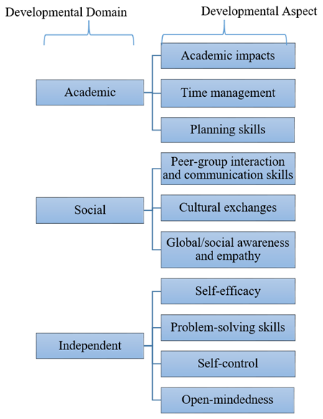
Survey items
Total of 77 self-report items
on a seven-point Likert scale
ranging from 1 (Strongly disagree)
to 7 (Strongly agree);
To measure the impact of hall
experience on academic, social and
independent developmental domains.

Slide 4
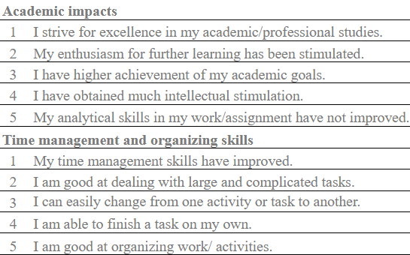
Survey items: Academic impacts
Likert scale: 1 (Strongly disagree) to 7 (Strongly agree)

Slide 5
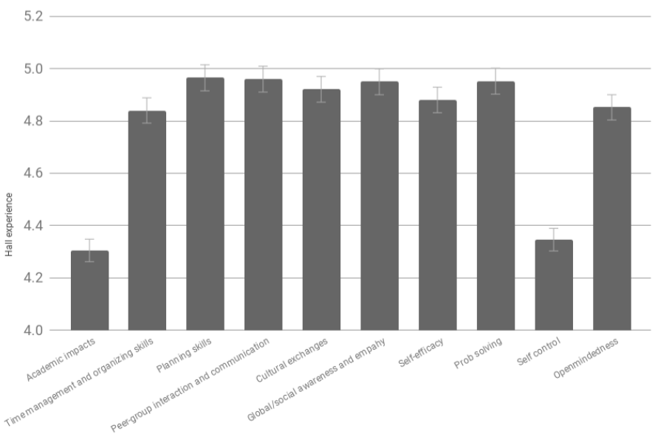
Impact of Hall Experiences on the 10 developmental aspects
All the developmental aspects
have been positively reported
above the midpoint of 4
Likert scale: 1 (Strongly disagree) to 7 (Strongly agree)

Slide 6
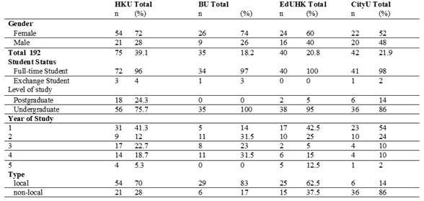
Interview participants in 2018/19
A total of 192 participants from 4 local universities in HK.

Slide 7
Interview questions
To understand the participants’ living experiences in residence halls, 4 open-ended questions were asked:
Q1: What do you think about the hall activities in general?
Q2: How do you rate your level of achievement for each of the residential educational aims?
Q3: How do you rate your level of achievement for each of the university educational aims?
Q4: Why do you think the alignment among residential educational and university educational aims should be in this way?

Slide 8
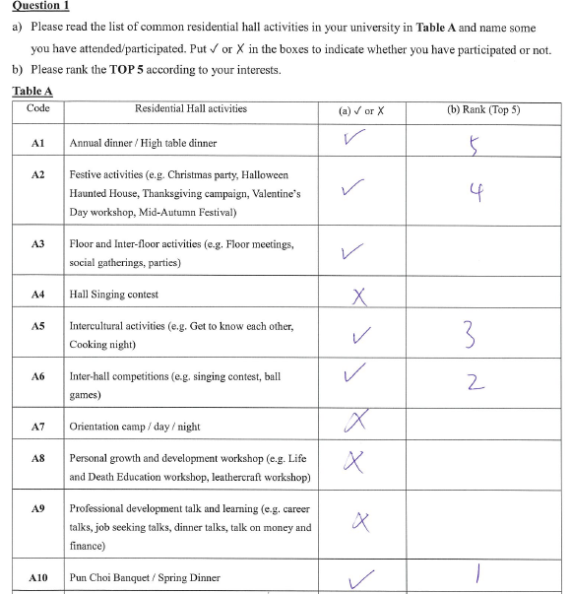
Q1: What do you think about the hall activities?
Consists of two parts:
Indicate the activities attended
in academic year 2018/19;
Rank the top 5 activities according
to participants’ interest.

Slide 9
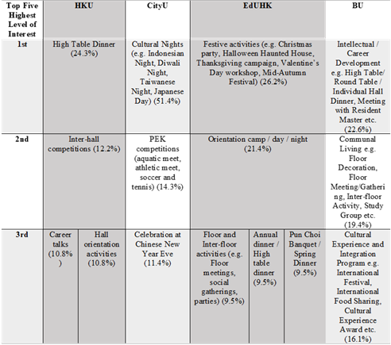
Q1: What do you think about the hall activities?
In general, events with
the most interests are some
with the highest participation,
mostly free and informal, with
the theme of celebrating, or
allowing students to bond and
to meet new people.
“They usually invite a lot of important guests
(to the High Table Dinner), for example the officer of CEDARS. Also, it is the chance for me to interact with the nonlocal students. I think it is a very important part of my hall life.”
- HKU student resident
Highest participation
Highest participation
Secondly highest participation
Highest participation
Thirdly highest participation
Thirdly highest participation
Thirdly highest participation
Secondly highest participation

Slide 10
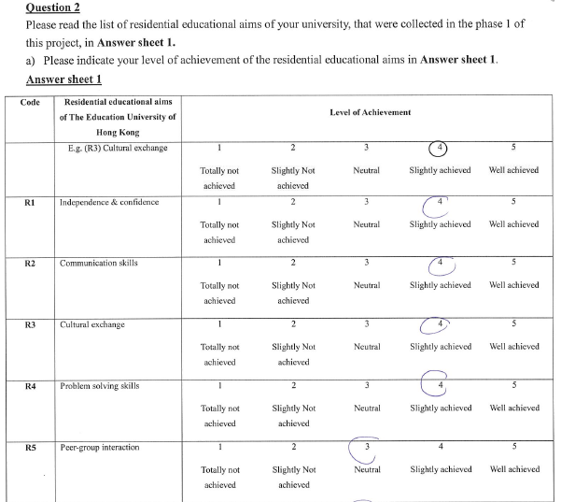
Q2: achievement of residential educational aims? - 1
To examine how well students have achieved the residential educational aims on a 5-point Likert scale ranging from 1 (Totally not achieved) to 3 (Neutral) to 5 (Totally achieved).
To collect anecdotal evidence of their achievement of the residential educational aims.

Slide 11
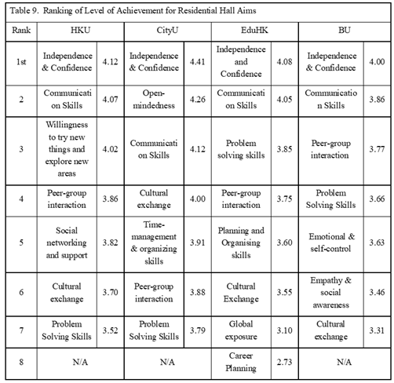
Q2: achievement of residential educational aims? - 2
“Independence & Confidence” was the most well-achieved residential educational aim ranked by students from all 4 universities.
“Communication Skills” was another prominent residential educational aim shared by all participating universities.
Based on self-report items on a 5-point likert-scale, ranging from 1 (Totally not achieved) to 3 (Neutral) to 5 (Totally achieved).

Slide 12
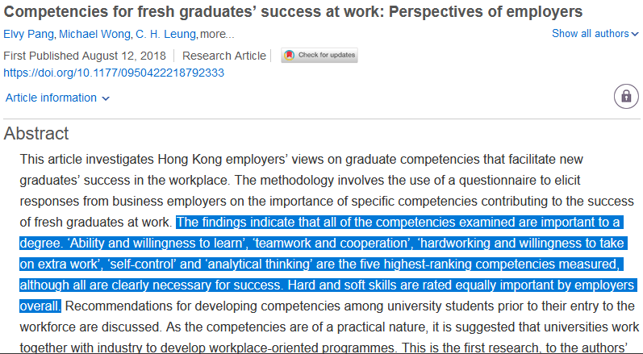
Q2: achievement of residential educational aims? - 3
Based on self-report items on a 5-point likert-scale, ranging from 1 (Totally not achieved) to 3 (Neutral) to 5 (Totally achieved).

Slide 13
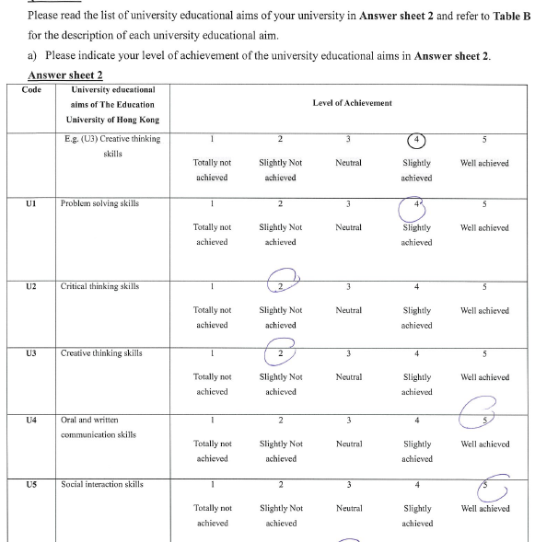
Q3: achievement of university educational aims?
To examine how well students have achieved the university educational aims on a 5-point Likert scale ranging from 1 (Totally not achieved) to 3 (Neutral) to 5 (Totally achieved).
To collect anecdotal evidence of their achievement of the university educational aims.

Slide 14
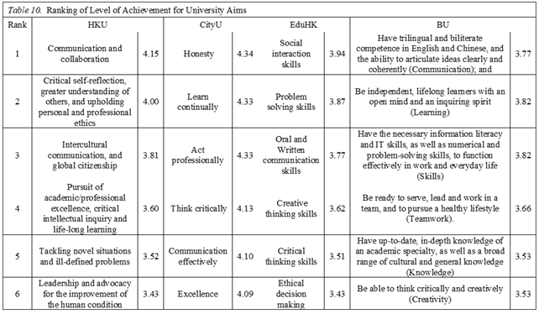
Q3: achievement of UNIVERSITY educational aims?
The university
educational aims with a focus on communication
skills were generally
ranked as well-achieved
by student residents
from all 4 universities.
Based on self-report items on a 5-point likert-scale, ranging from 1 (Totally not achieved) to 3 (Neutral) to 5 (Totally achieved).

Slide 15
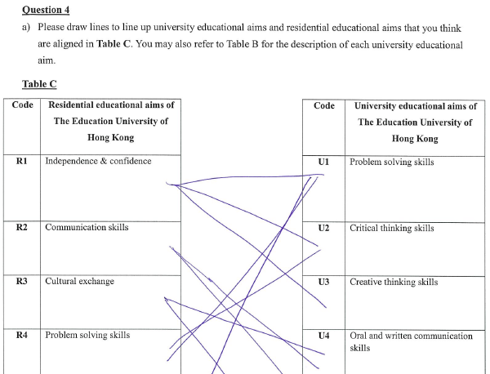
Q4: the alignment among residential educational and university educational aims
To examine how well the residential educational aims align with the university educational aims from the perspectives of student residents.

Slide 16
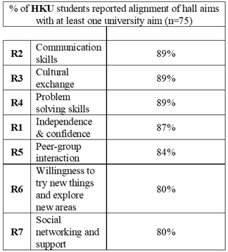
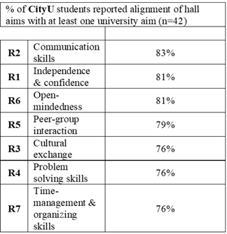
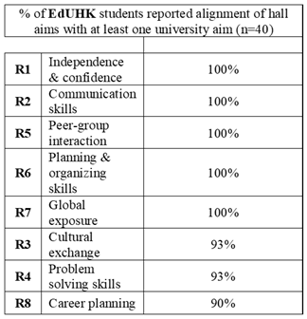
Q4: the alignment among residential educational and university educational aims

Slide 17
Additional interview question asked in this year… - 1
An open-ended question was added to the interview protocol of this academic year (2019/20) to reflect the impact of unexpected situations occurred, e.g. the social unrest in Sem 1 and the virus outbreak in Sem 2:
Would you share with us how the unexpected situations drew impacts on your hall life?

Slide 18
Additional interview question asked in this year…- 2
Q: Would you share with us how the unexpected situations drew impacts on your hall life?
“Many of the activities require human resources to run and then actually even there is some hall activities still being held but not many participants joining the activities so I would think that lacking of social interaction would be the greatest impact on the hall life because of the situation… I would say it's quite meaningless to live in a hall without social interaction.” - HKU Hallmate 4

Slide 19
Additional interview question asked in this year… - 3
Q: Which hall activities you wish you could attend but you missed out this year and why?
“I would say Farewell High Table Dinner, I can’ join all activities that I am interested in semester 1 but for all High Table Dinner are cancelled in semester 2, especially for the Farewell High Table Dinner that something I look forward to for like a few years because it is my last year living in hall and I would say it would be a memory to me but I can’t participate in those activities but it is quite a pity that I can’t join the Farewell High Table Dinner I would say, we can’t take photos, we can’t play games,that’s kind of sad. I would like to join the society service trip if I get a chance but since every year around that time I am occupied for other hall activities so I couldn’t join as well, so these two would be the most I am interested but I cannot join this year” - HKU Hallmate 4

